Slide 1
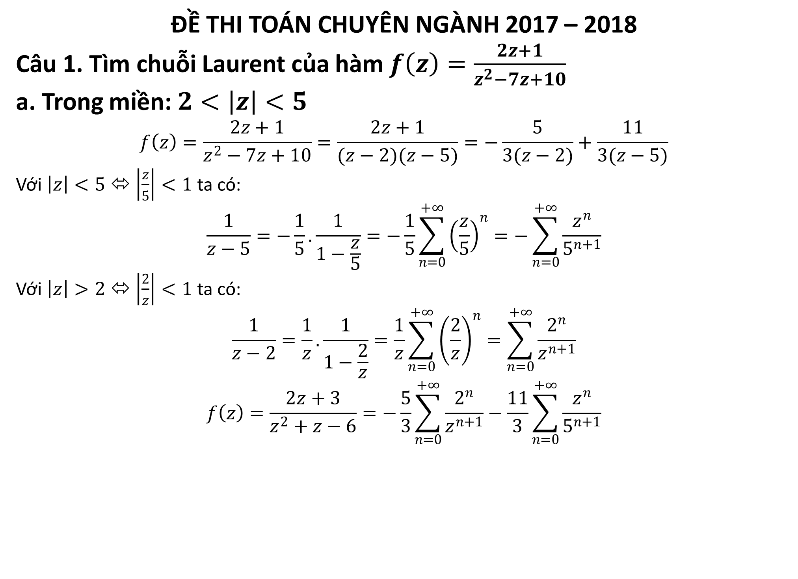
ĐỀ THI TOÁN CHUYÊN NGÀNH 2017 – 2018
Câu 1. Tìm chuỗi Laurent của hàm $f\left(z\right)=\frac{2z+1}{z^{2}−7z+10}$
a. Trong miền: $2<\left|z\right|<5$
$$f\left(z\right)=\frac{2z+1}{z^{2}−7z+10}=\frac{2z+1}{(z−2)(z−5)}=−\frac{5}{3(z−2)}+\frac{11}{3(z−5)}$$
Với $\left|z\right|<5$ ⬄ $\left|\frac{z}{5}\right|<1$ ta có:
$$\frac{1}{z−5}=−\frac{1}{5}.\frac{1}{1−\frac{z}{5}}=−\frac{1}{5}\sum_{n=0}^{+∞}{{\left(\frac{z}{5}\right)}^{n}}=−\sum_{n=0}^{+∞}{\frac{z^{n}}{5^{n+1}}}$$
Với $\left|z\right|>2$ ⬄ $\left|\frac{2}{z}\right|<1$ ta có:
$$\frac{1}{z−2}=\frac{1}{z}.\frac{1}{1−\frac{2}{z}}=\frac{1}{z}\sum_{n=0}^{+∞}{{\left(\frac{2}{z}\right)}^{n}}=\sum_{n=0}^{+∞}{\frac{2^{n}}{z^{n+1}}}$$
$$f\left(z\right)=\frac{2z+3}{z^{2}+z−6}=−\frac{5}{3}\sum_{n=0}^{+∞}{\frac{2^{n}}{z^{n+1}}−\frac{11}{3}\sum_{n=0}^{+∞}{\frac{z^{n}}{5^{n+1}}}}$$

Slide 2
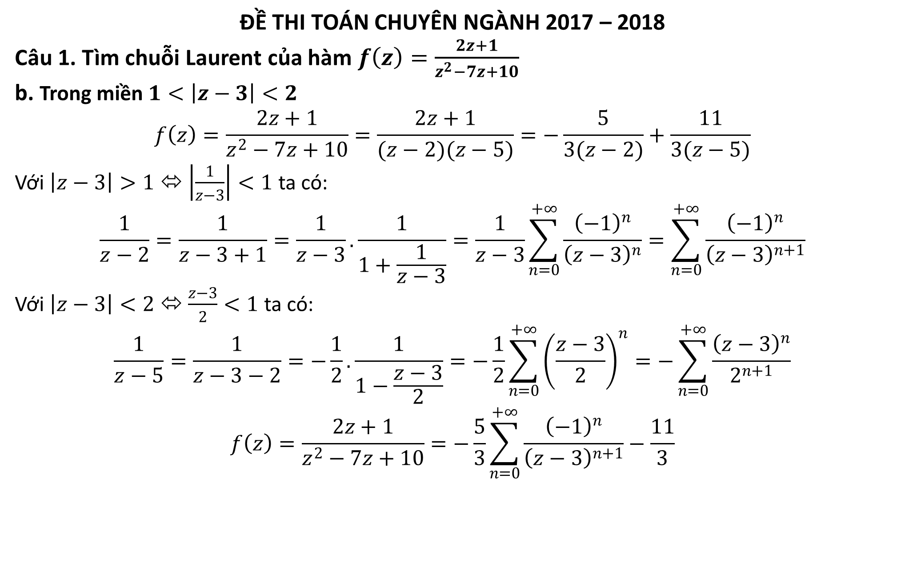
ĐỀ THI TOÁN CHUYÊN NGÀNH 2017 – 2018
Câu 1. Tìm chuỗi Laurent của hàm $f\left(z\right)=\frac{2z+1}{z^{2}−7z+10}$
b. Trong miền $1<\left|z−3\right|<2$
$$f\left(z\right)=\frac{2z+1}{z^{2}−7z+10}=\frac{2z+1}{(z−2)(z−5)}=−\frac{5}{3(z−2)}+\frac{11}{3(z−5)}$$
Với $\left|z−3\right|>1$ ⬄ $\left|\frac{1}{z−3}\right|<1$ ta có:
$$\frac{1}{z−2}=\frac{1}{z−3+1}=\frac{1}{z−3}.\frac{1}{1+\frac{1}{z−3}}=\frac{1}{z−3}\sum_{n=0}^{+∞}{\frac{{\left(−1\right)}^{n}}{{\left(z−3\right)}^{n}}=\sum_{n=0}^{+∞}{\frac{{\left(−1\right)}^{n}}{{\left(z−3\right)}^{n+1}}}}$$
Với $\left|z−3\right|<2$ ⬄ $\frac{z−3}{2}<1$ ta có:
$$\frac{1}{z−5}=\frac{1}{z−3−2}=−\frac{1}{2}.\frac{1}{1−\frac{z−3}{2}}=−\frac{1}{2}\sum_{n=0}^{+∞}{{\left(\frac{z−3}{2}\right)}^{n}}=−\sum_{n=0}^{+∞}{\frac{{\left(z−3\right)}^{n}}{2^{n+1}}}$$
$$f\left(z\right)=\frac{2z+1}{z^{2}−7z+10}=−\frac{5}{3}\sum_{n=0}^{+∞}{\frac{{\left(−1\right)}^{n}}{{\left(z−3\right)}^{n+1}}}−\frac{11}{3}$$

Slide 3
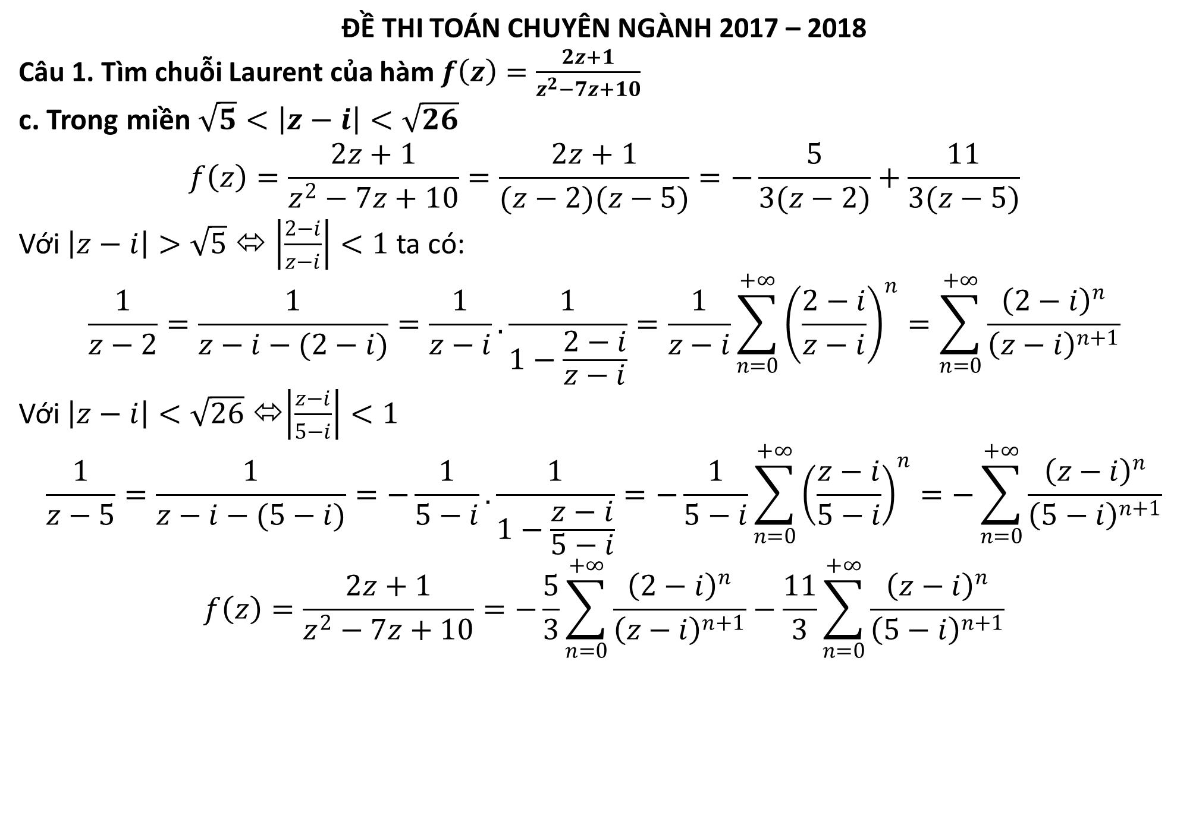
ĐỀ THI TOÁN CHUYÊN NGÀNH 2017 – 2018
Câu 1. Tìm chuỗi Laurent của hàm $f\left(z\right)=\frac{2z+1}{z^{2}−7z+10}$
c. Trong miền $\sqrt{5}<\left|z−i\right|<\sqrt{26}$
$$f\left(z\right)=\frac{2z+1}{z^{2}−7z+10}=\frac{2z+1}{(z−2)(z−5)}=−\frac{5}{3(z−2)}+\frac{11}{3(z−5)}$$
Với $\left|z−i\right|>\sqrt{5}$ ⬄ $\left|\frac{2−i}{z−i}\right|<1$ ta có:
$$\frac{1}{z−2}=\frac{1}{z−i−(2−i)}=\frac{1}{z−i}.\frac{1}{1−\frac{2−i}{z−i}}=\frac{1}{z−i}\sum_{n=0}^{+∞}{{\left(\frac{2−i}{z−i}\right)}^{n}}=\sum_{n=0}^{+∞}{\frac{{\left(2−i\right)}^{n}}{{\left(z−i\right)}^{n+1}}}$$
Với $\left|z−i\right|<\sqrt{26}$ ⬄$\left|\frac{z−i}{5−i}\right|<1$
$$\frac{1}{z−5}=\frac{1}{z−i−(5−i)}=−\frac{1}{5−i}.\frac{1}{1−\frac{z−i}{5−i}}=−\frac{1}{5−i}\sum_{n=0}^{+∞}{{\left(\frac{z−i}{5−i}\right)}^{n}}=−\sum_{n=0}^{+∞}{\frac{{\left(z−i\right)}^{n}}{{\left(5−i\right)}^{n+1}}}$$
$$f\left(z\right)=\frac{2z+1}{z^{2}−7z+10}=−\frac{5}{3}\sum_{n=0}^{+∞}{\frac{{\left(2−i\right)}^{n}}{{\left(z−i\right)}^{n+1}}}−\frac{11}{3}\sum_{n=0}^{+∞}{\frac{{\left(z−i\right)}^{n}}{{\left(5−i\right)}^{n+1}}}$$

Slide 4
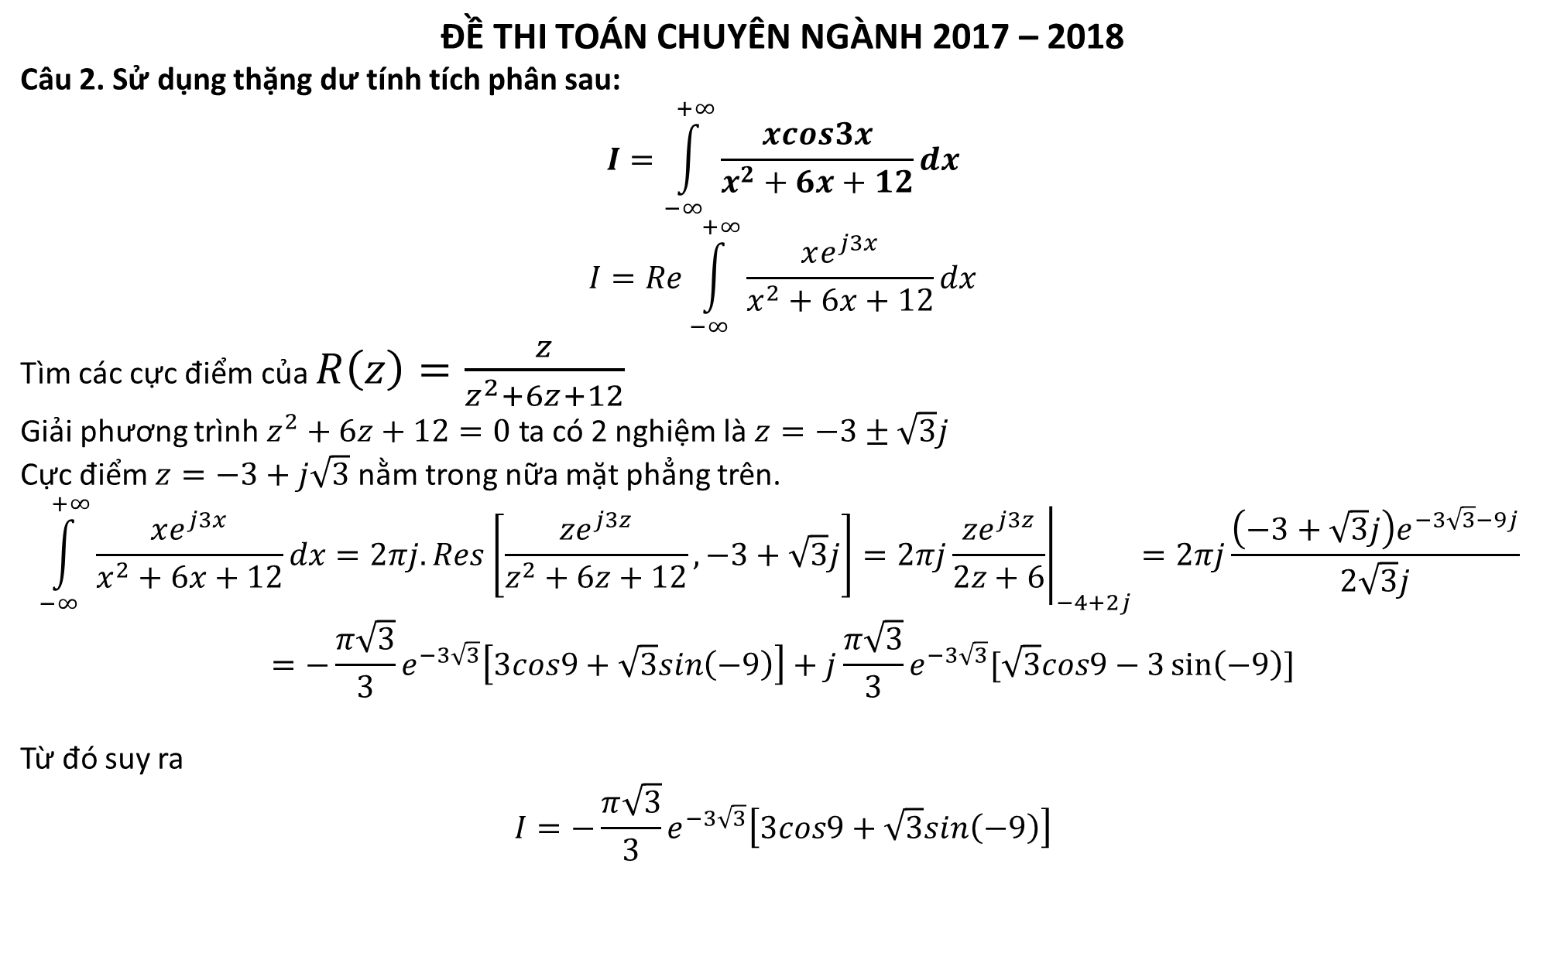
ĐỀ THI TOÁN CHUYÊN NGÀNH 2017 – 2018
Câu 2. Sử dụng thặng dư tính tích phân sau:
$$I=\int_{−∞}^{+∞}{\frac{xcos3x}{x^{2}+6x+12}dx}$$
$$I=Re\int_{−∞}^{+∞}{\frac{xe^{j3x}}{x^{2}+6x+12}dx}$$
Tìm các cực điểm của $R\left(z\right)=\frac{z}{z^{2}+6z+12}$
Giải phương trình $z^{2}+6z+12=0$ ta có 2 nghiệm là $z=−3±\sqrt{3}j$
Cực điểm $z=−3+j\sqrt{3}$ nằm trong nữa mặt phẳng trên.
$$\int_{−∞}^{+∞}{\frac{xe^{j3x}}{x^{2}+6x+12}dx}=2πj.Res\left[\frac{ze^{j3z}}{z^{2}+6z+12},−3+\sqrt{3}j\right]=2πj{\left.\frac{ze^{j3z}}{2z+6}\right|}_{−4+2j}=2πj\frac{\left(−3+\sqrt{3}j\right)e^{−3\sqrt{3}−9j}}{2\sqrt{3}j}$$
$$=−\frac{π\sqrt{3}}{3}e^{−3\sqrt{3}}\left[3cos9+\sqrt{3}sin\left(−9\right)\right]+j\frac{π\sqrt{3}}{3}e^{−3\sqrt{3}}[\sqrt{3}cos9−3\sin\left(−9\right)]$$
Từ đó suy ra
$$I=−\frac{π\sqrt{3}}{3}e^{−3\sqrt{3}}\left[3cos9+\sqrt{3}sin\left(−9\right)\right]$$
Ta có:

Slide 5
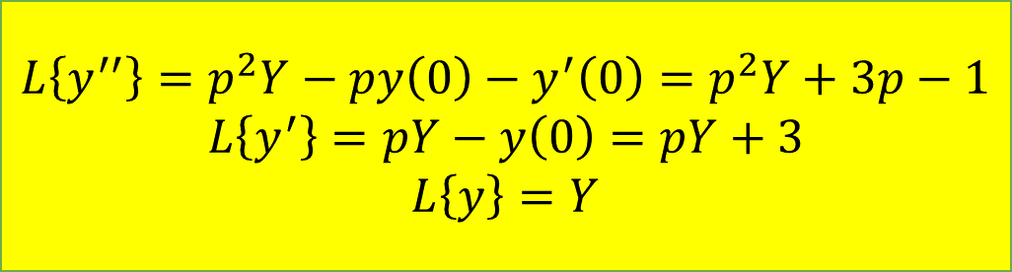
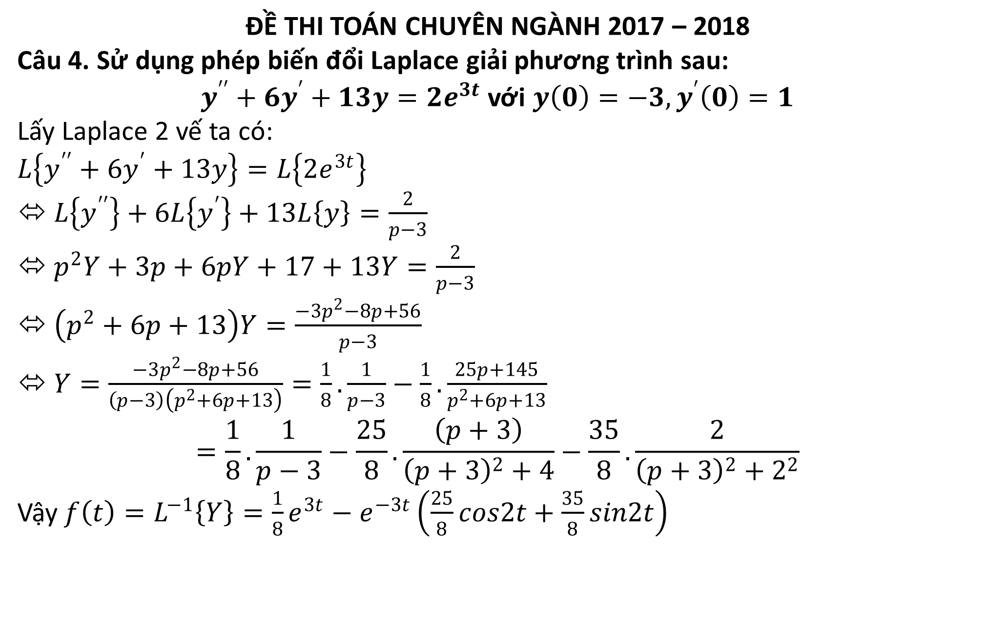
ĐỀ THI TOÁN CHUYÊN NGÀNH 2017 – 2018
Câu 4. Sử dụng phép biến đổi Laplace giải phương trình sau:
$y^{′′}+6y^{′}+13y=2e^{3t}$ với $y\left(0\right)=−3, y^{′}\left(0\right)=1$
Lấy Laplace 2 vế ta có:
$$L\left\{y^{′′}+6y^{′}+13y\right\}=L\left\{2e^{3t}\right\}$$
⬄ $L\left\{y^{′′}\right\}+6L\left\{y^{′}\right\}+13L\left\{y\right\}=\frac{2}{p−3}$
⬄ $p^{2}Y+3p+6pY+17+13Y=\frac{2}{p−3}$
⬄ $\left(p^{2}+6p+13\right)Y=\frac{−3p^{2}−8p+56}{p−3}$
⬄ $Y=\frac{−3p^{2}−8p+56}{\left(p−3\right)\left(p^{2}+6p+13\right)}=\frac{1}{8}.\frac{1}{p−3}−\frac{1}{8}.\frac{25p+145}{p^{2}+6p+13}$
$$=\frac{1}{8}.\frac{1}{p−3}−\frac{25}{8}.\frac{\left(p+3\right)}{{\left(p+3\right)}^{2}+4}−\frac{35}{8}.\frac{2}{{\left(p+3\right)}^{2}+2^{2}}$$
Vậy $f\left(t\right)=L^{−1}\left\{Y\right\}=\frac{1}{8}e^{3t}−e^{−3t}\left(\frac{25}{8}cos2t+\frac{35}{8}sin2t\right)$
$$L\left\{y^{′′}\right\}=p^{2}Y−py\left(0\right)−y^{′}\left(0\right)=p^{2}Y+3p−1$$
$$L\left\{y^{′}\right\}=pY−y\left(0\right)=pY+3$$
$$L\left\{y\right\}=Y$$

